Slide 1


Hii, Iam Siddhika
Welcome to Power BI Series
Part -15

Slide 2

Today Content
Are you ready guys?
continuing with
CREATING A DATA MODEL
HIDING FIELDS MODEL LAYOUTS DATA FORMATS & CATEGORIES

Slide 3
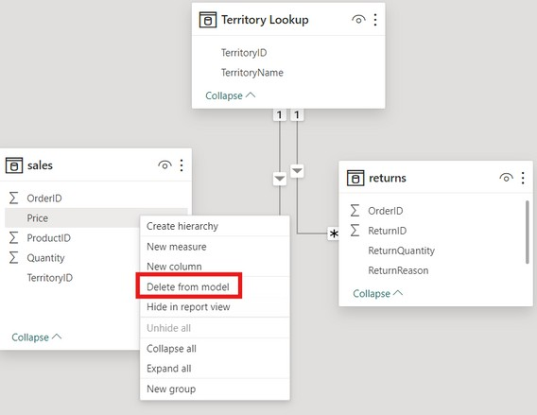

HIDING FIELDS
Hide in Report View makes fields inaccessible from the Report tab, but still available in Data and Model views
Have you tried?
This can be controlled by right-clicking a field in the Data or Model view, or by selecting “Is hidden” in the Properties pane
This is commonly used to prevent users from filtering using invalid fields, reduce clutter, or to hide irrelevant metrics from
view
TIP: Hide the foreign keys in fact tables to force users to filter using primary keys in dimension tables

Slide 4
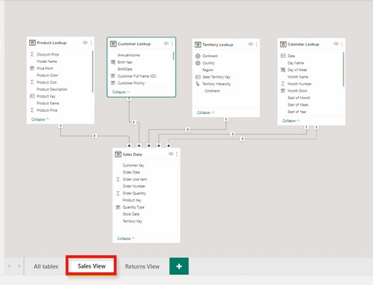
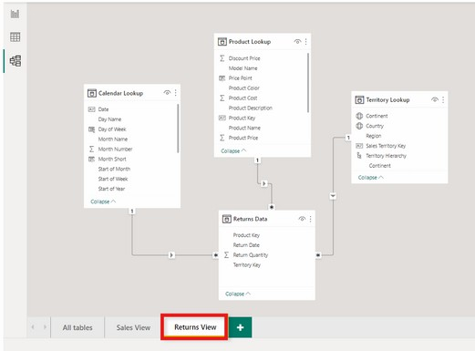


MODEL LAYOUTS
Organize like
this.
Model layouts allow you to create custom views to show specific portions of large, complex models.
Here we’ve created a Sales View displaying only tables related to sales, and a Returns View displaying only tables related to returns.
(Note: this doesn’t actually create duplicate tables)

Slide 5
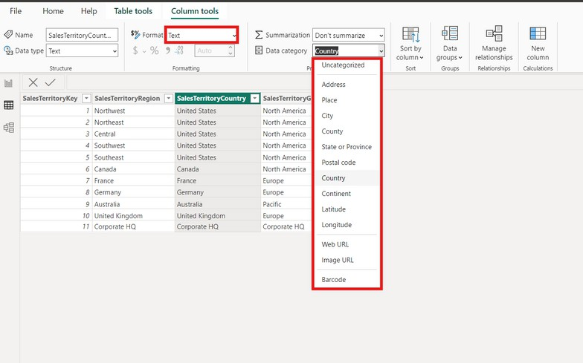

DATA FORMATS & CATEGORIES
Customize data formats from the Column tools menu in the Data view or the Properties pane in the Model view
Check this
Assign data categories for geospatial fields, URLs or barcodes
This is commonly used to help Power BI map location- based fields like addresses, countries, cities,
coordinates, zip codes, etc.

Slide 6


Thank you for joining me today to learn about Part -15 of Power BI!
Remember, mastering data modeling techniques is key to unlocking the full potential of Power BI.
Stay tuned for more insights and tips on Power BI in our next Series.
Follow
Siddhika Shah

